Slide 1
CAPSTONE PROJECT-1
Customer Segmentation
RFM Analysis
K-Means Modelling
Cohort Analysis

Slide 2
Contents
Group Members
Main Steps
Meeting Schedule
Methodology
RFM Analysis
K-Means Modelling
Cohort Analysis

Slide 3
Group Members
DA2101 - Oğuzhan
DA2102 - Birgül
DA2103 - Pakize

Slide 4
Main StepS
Data Cleaning & EDA
RFM Analysis
RFM Segmentation
K-Means Modelling
Cohort Analysis

Slide 5
Schedule
17.10 Data Cleaning & EDA
18.10 RFM Analysis & Segmentation
19.10 K-Means Modelling
20.10 Cohort Analysis
21.10 Review

Slide 6
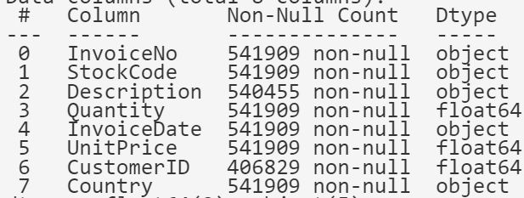
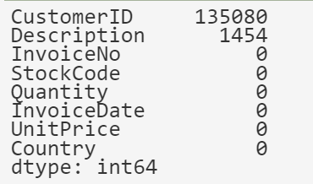
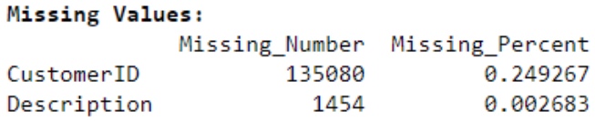
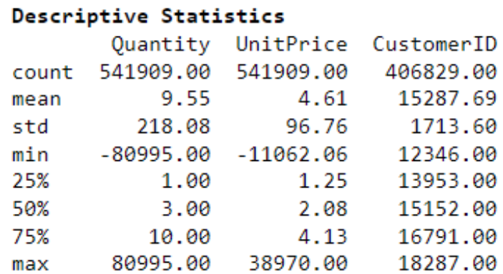
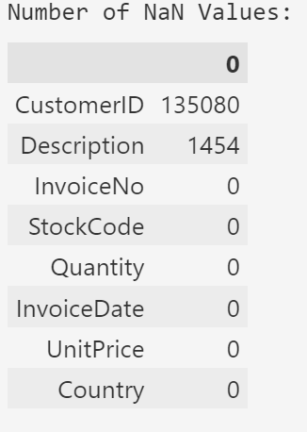
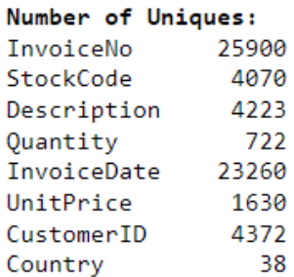
Methodology
Columns: 8 Rows: 541.909 Duplicated: 5.118

Slide 7
Methodology
25.900 unique invoices
9.288 cancelled invoices

Slide 8
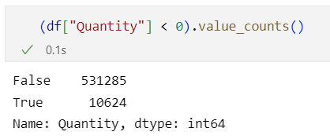
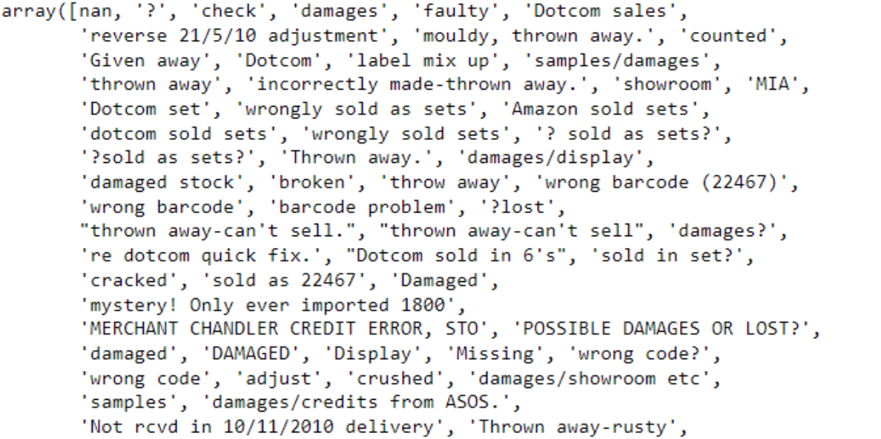

Slide 9
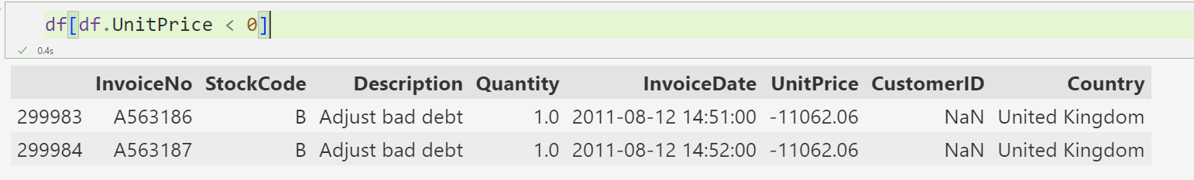
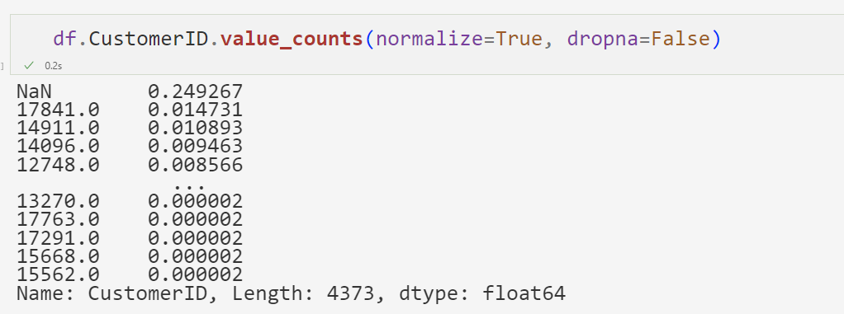
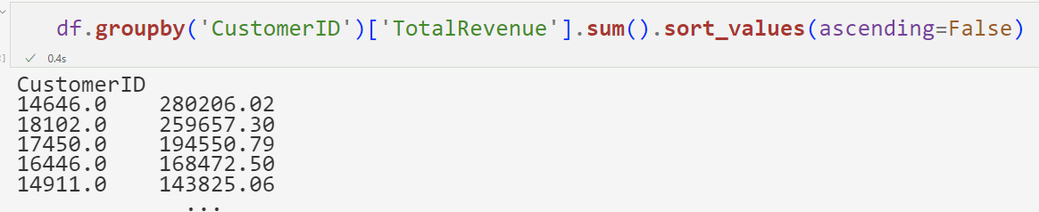

Slide 10
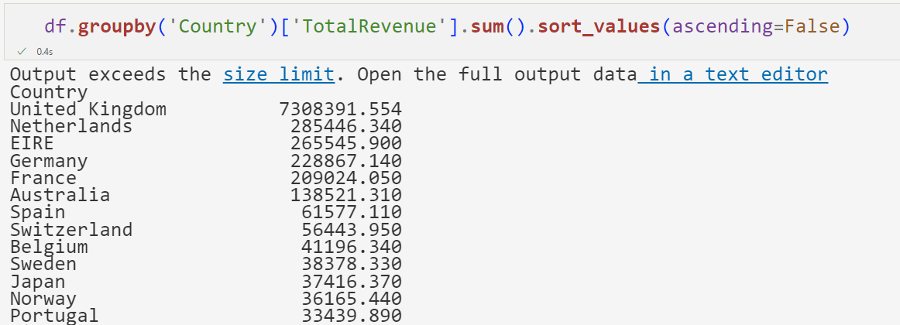
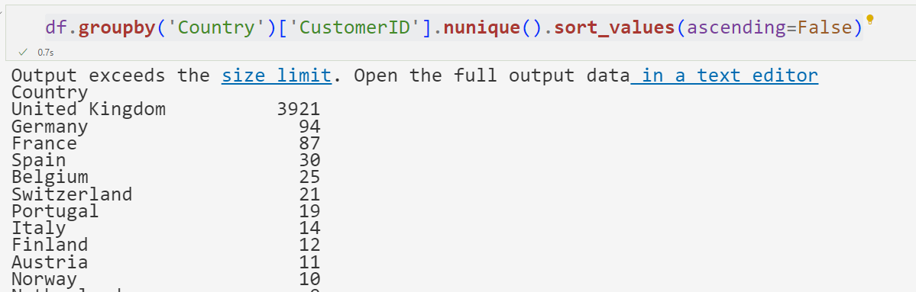

Slide 11
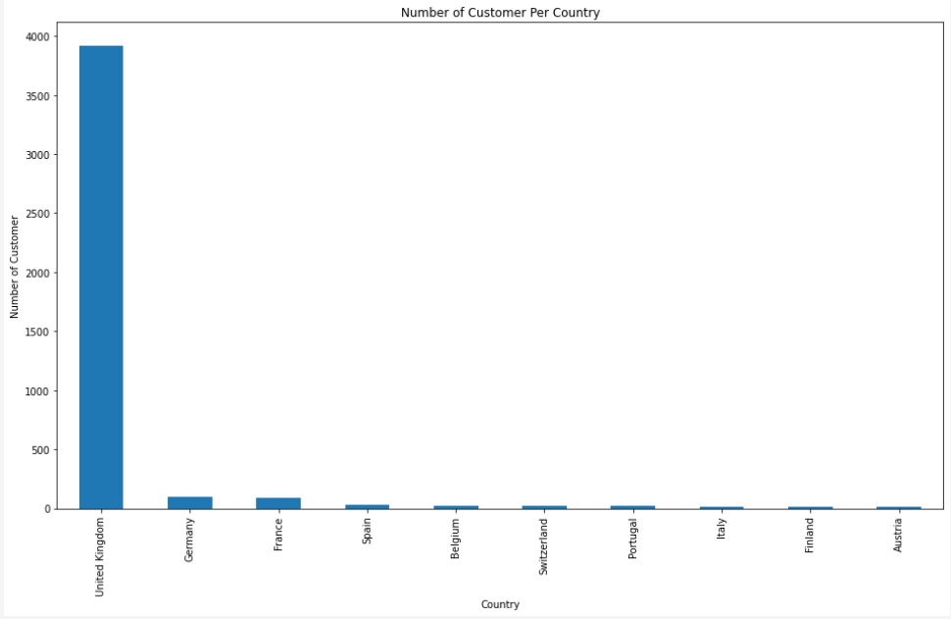

Slide 12

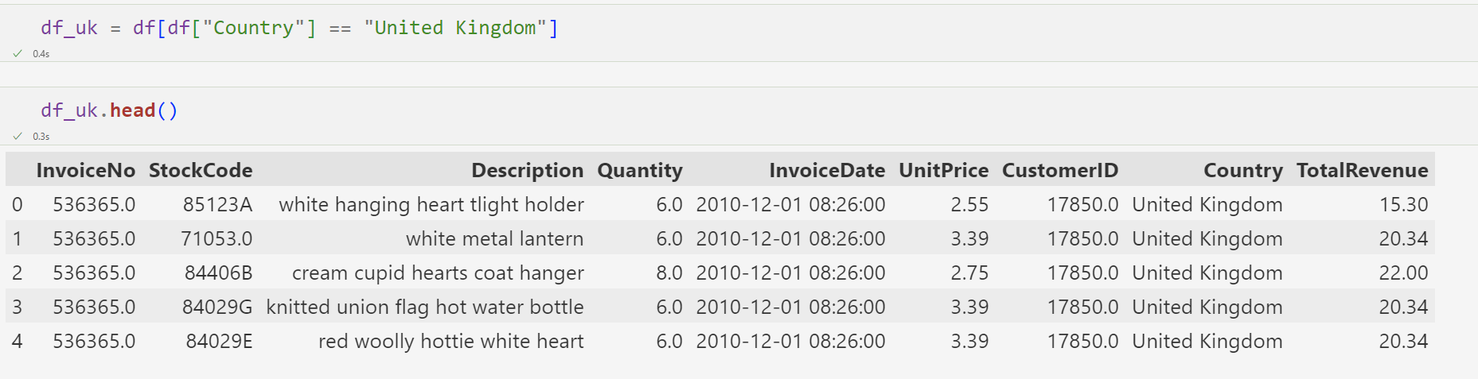
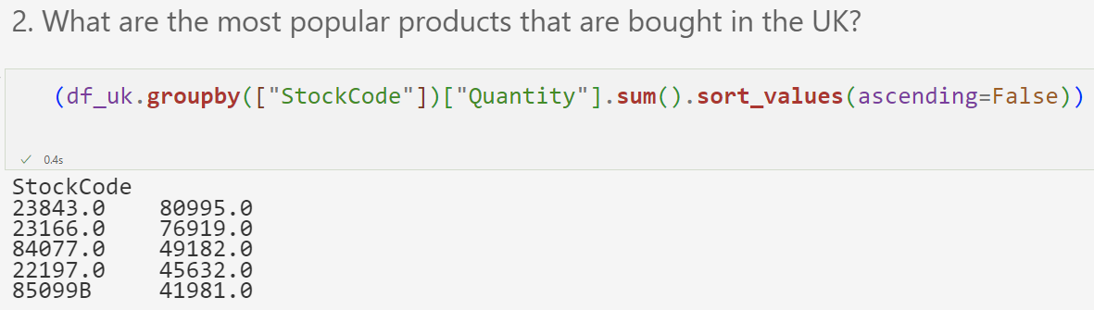
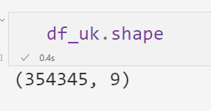

Slide 13
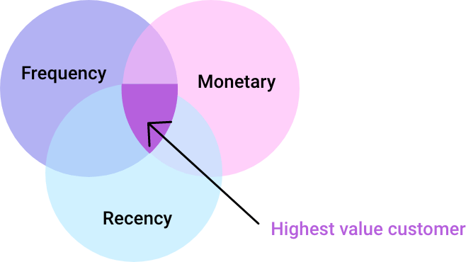

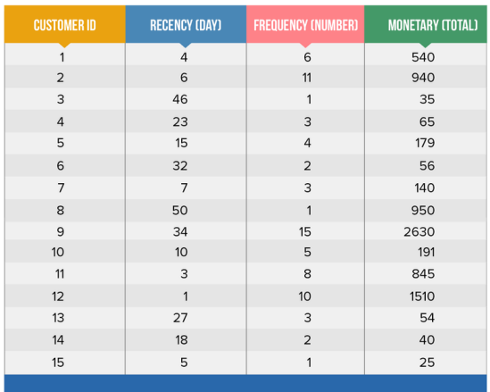
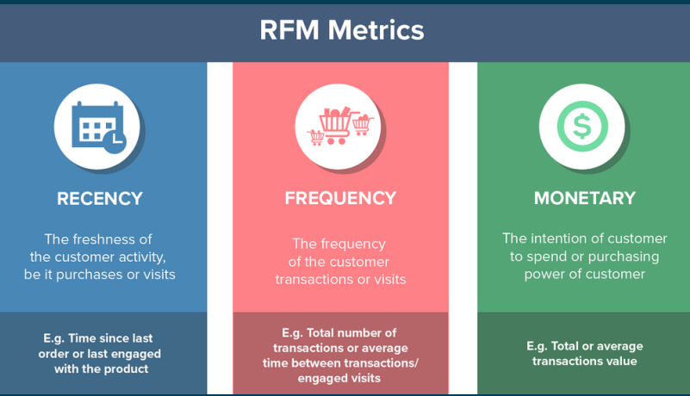

Slide 14
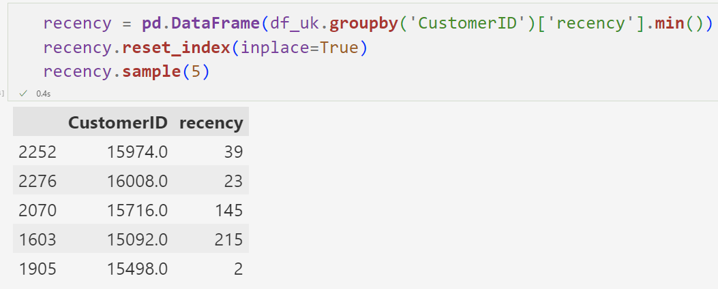
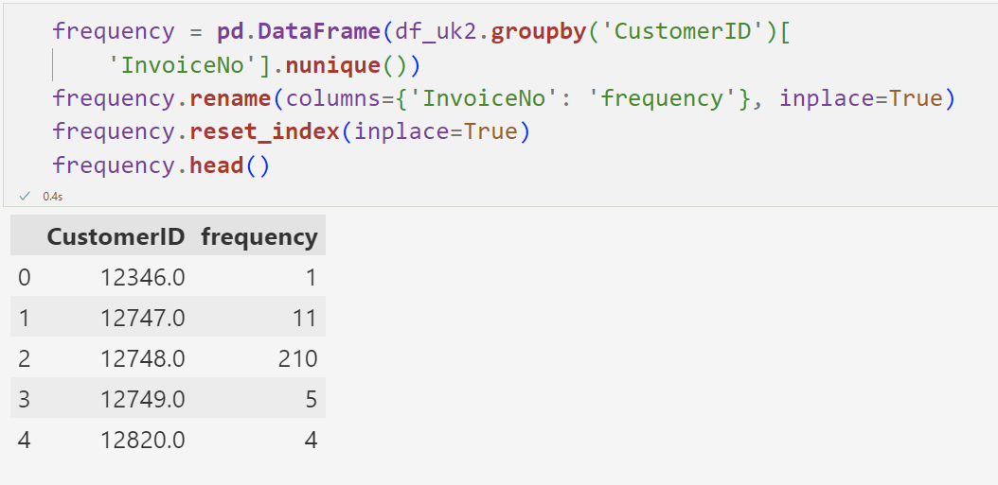

Slide 15
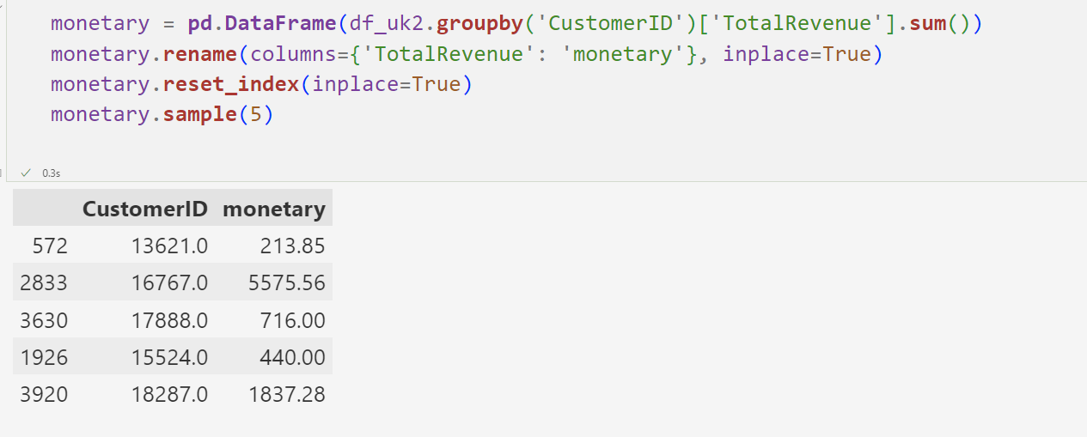

Slide 16
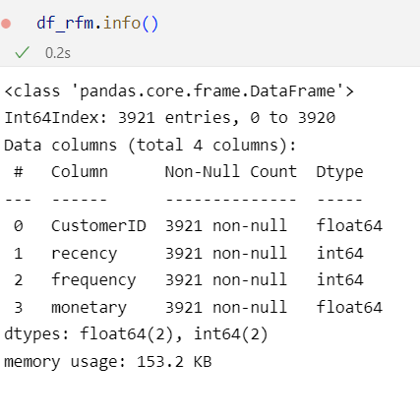
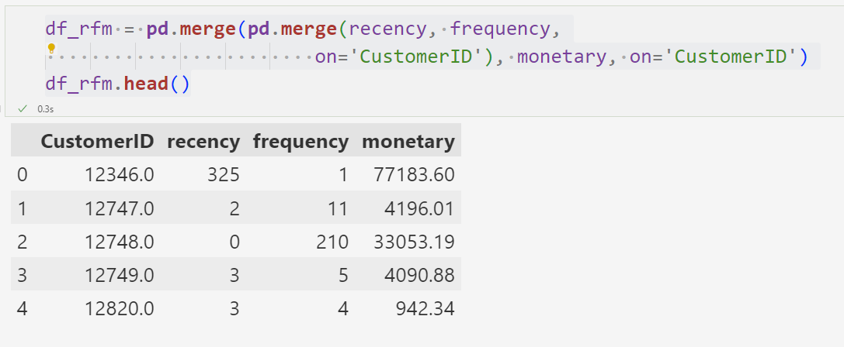

Slide 17
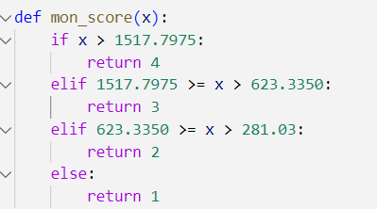
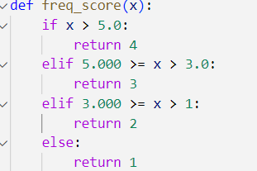
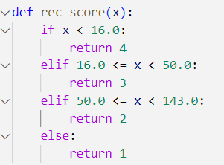
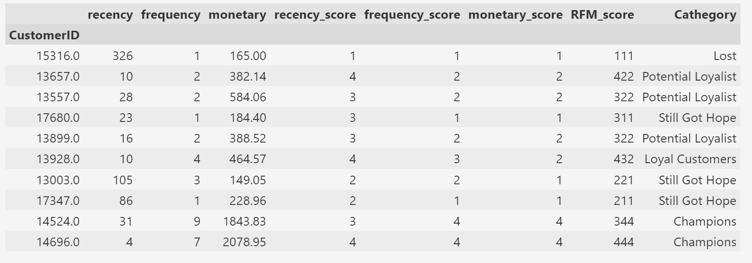
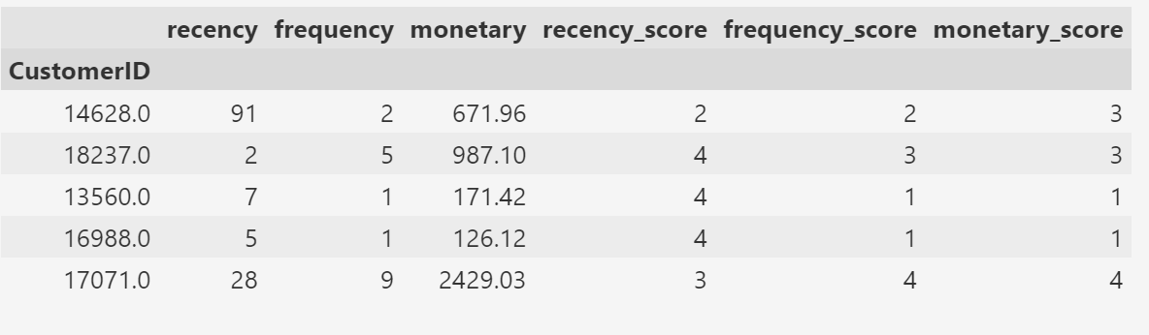

Slide 18
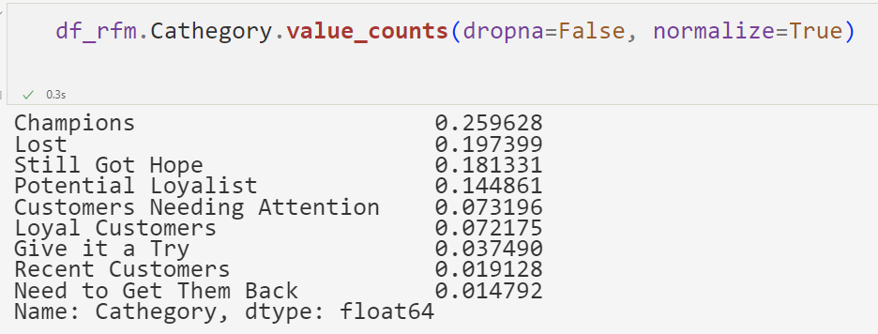
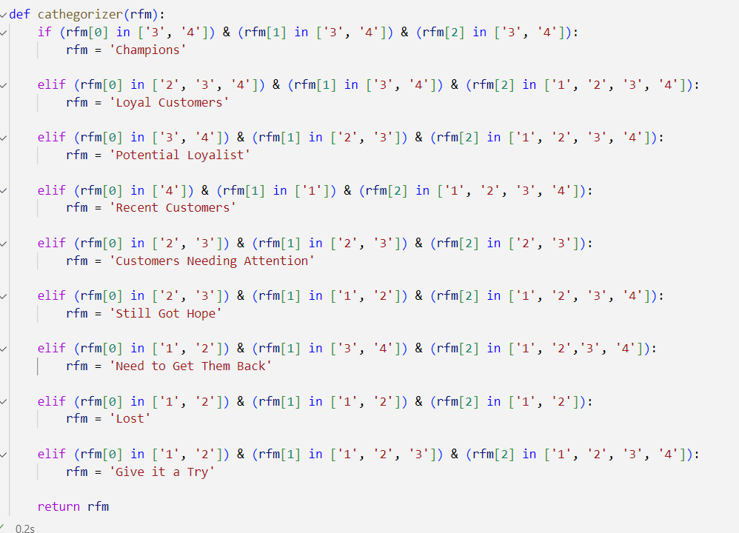

Slide 19
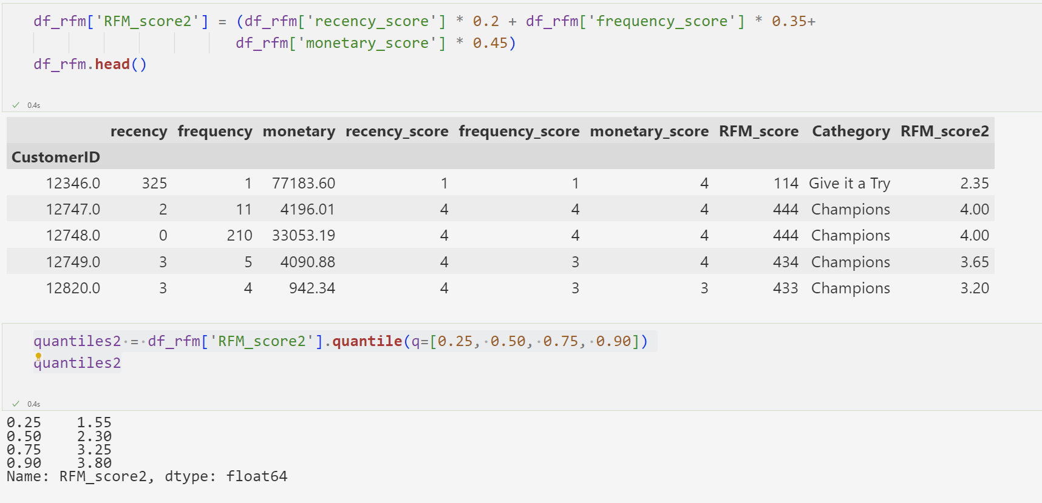
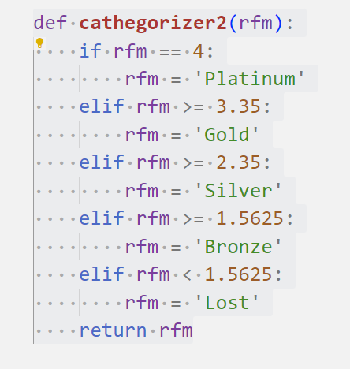
Method 2

Slide 20
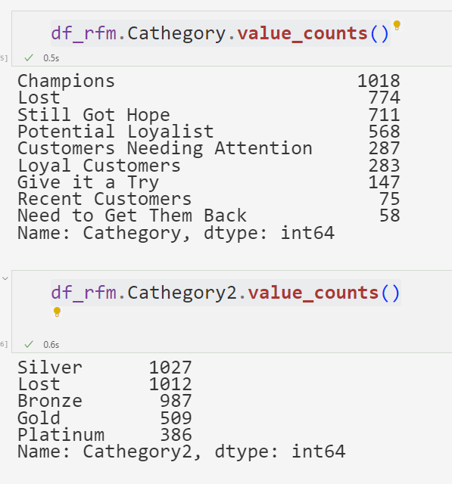
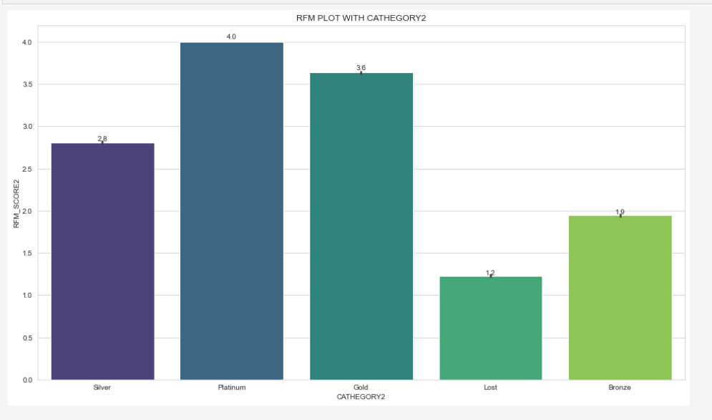

Slide 21
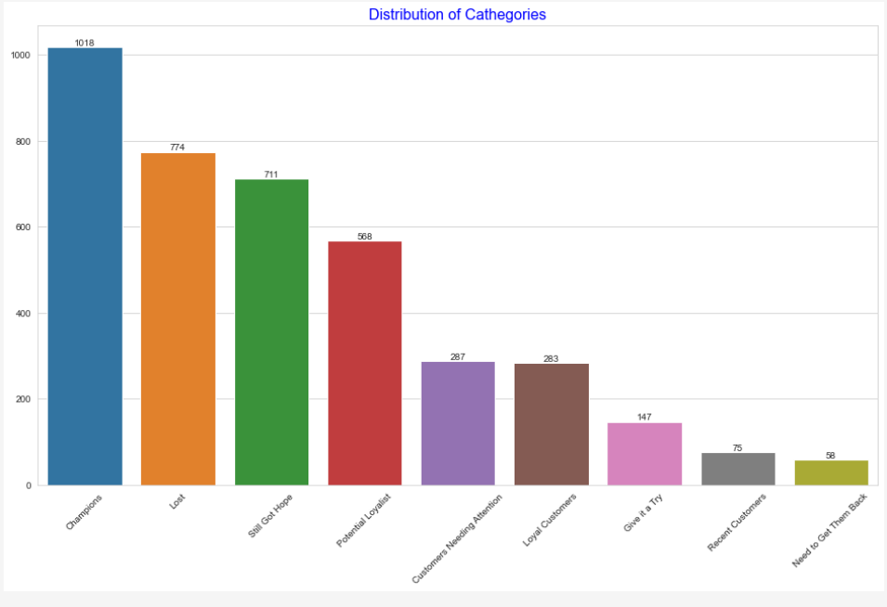

Slide 22
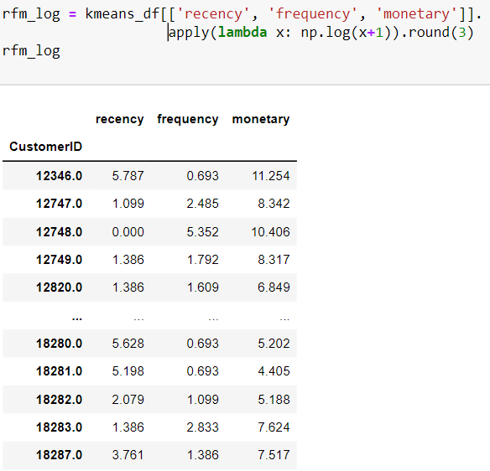
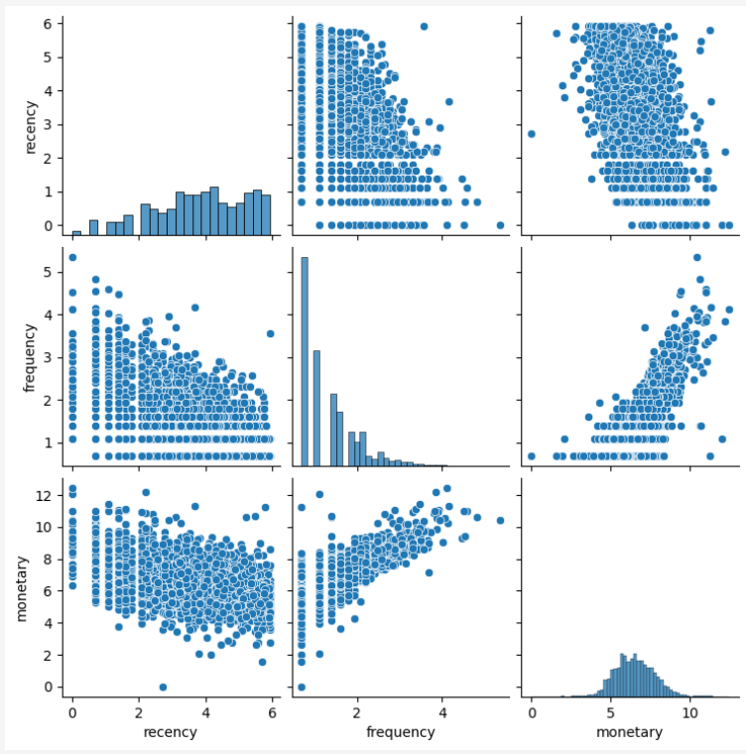
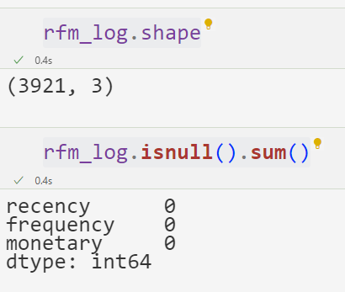

Slide 23
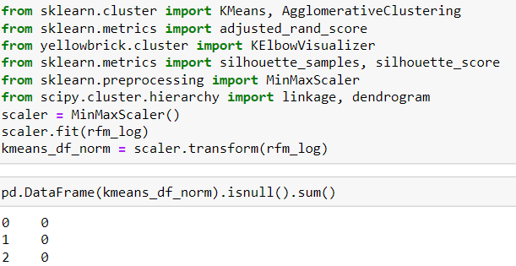
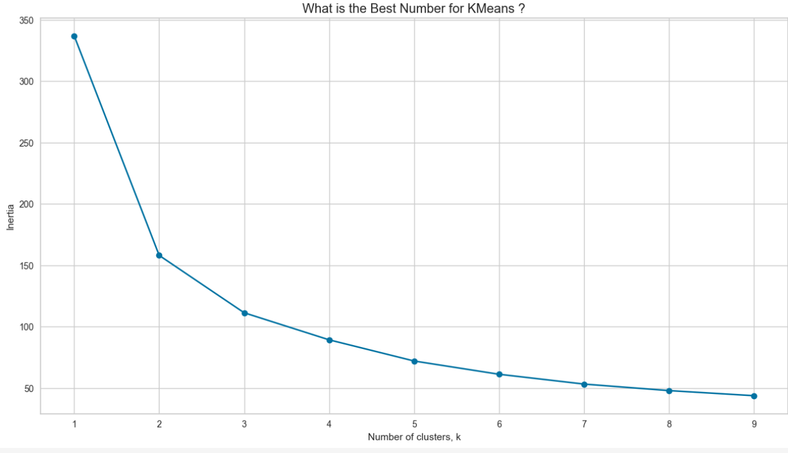
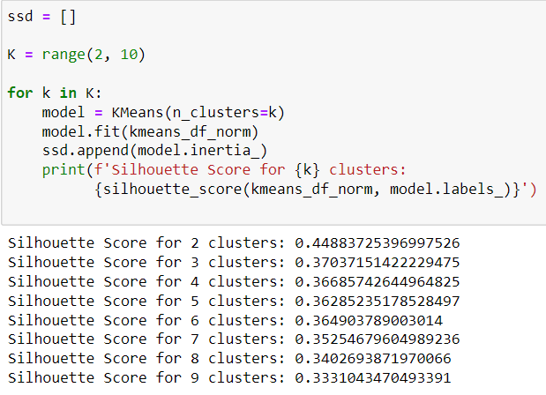
K-Means Implementation

Slide 24
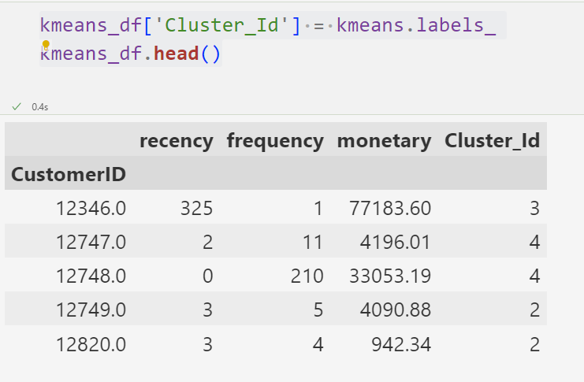
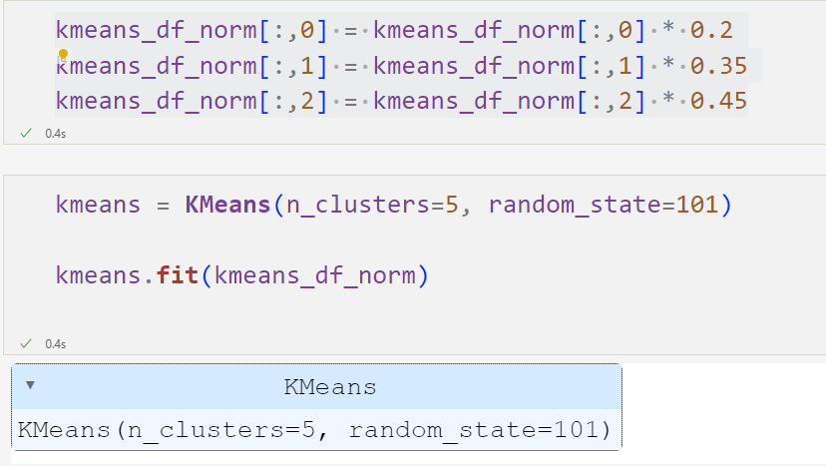
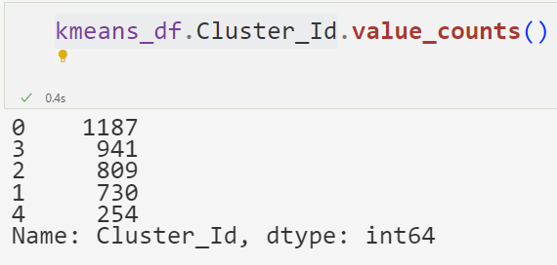
Model Fitting

Slide 25
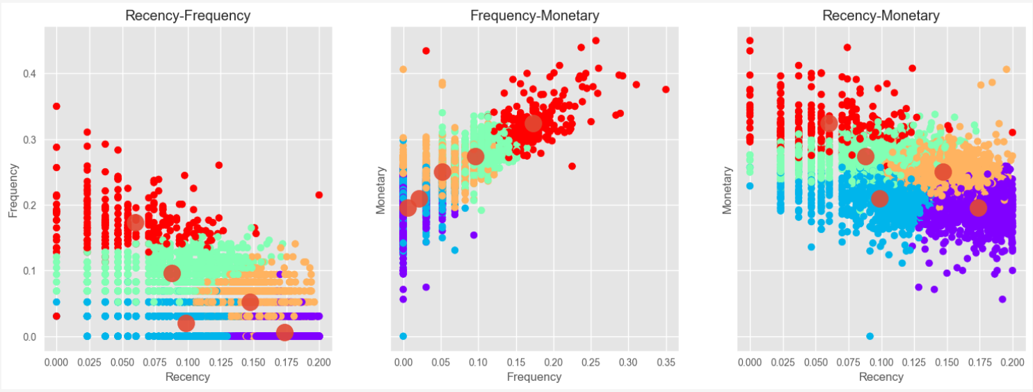
Visualize the Clusters

Slide 26
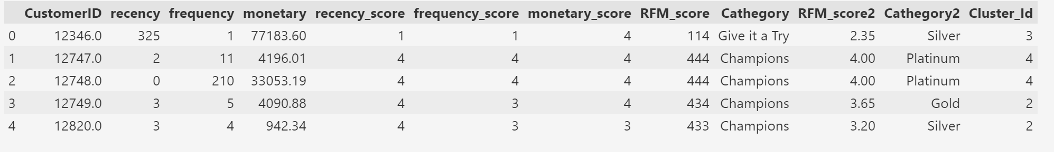
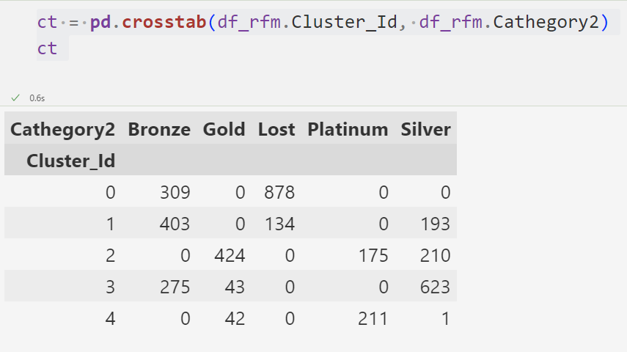
Assigning the Label

Slide 27
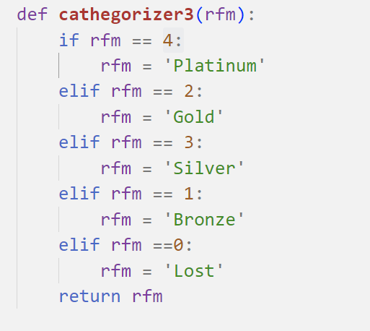


K-Means

Slide 28


Slide 29


Slide 30


Slide 31
CONCLUSION
During the project, we performed three different types of analyses independently. All three analysis methods offer some specific advantages and also have limitations. In this project, we were able to see in which area and to what extent we should use these methods.
First, we used RFM segmentation to divide our customers into insightful clusters. What makes RFM analysis attractive is the flexibility it offers. We can specify the segmentation in terms of our business needs. On the other hand, it is susceptible to user-induced biases.
Then we applied K-Means clustering to see the unsupervised machine learning results as clusters. Since our dataset does not have a significant tendency to cluster, K-Means clustering did not produce a satisfactory clustering.
Finally, we used cohort analysis to gain new insights from the data related to time-based cohorts. The strength of cohort analysis is its elasticity, as it provides specific analysis based on business needs.

